Slide 1
Micflix
Sprint: 4
A netflix clone - by Mickey Krekels
Class: RB04

Slide 2
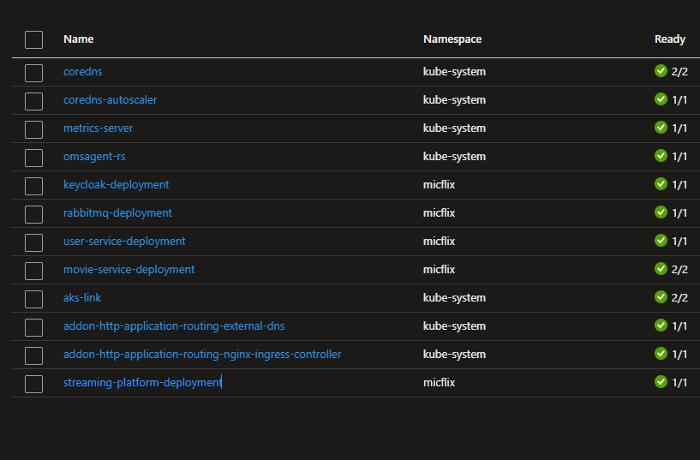
Introduction
Sprint goal
Achievements
Architecture
Foundation Topics
Enterprise Architecture & Software Platforms
Architecture & Quality
Messaging & Security-by-Design
DevSecOps & Cloud Services
Roadmap
Next steps

Slide 3
Sprint goal
The main goal for this sprint was to improve upon Security and to deploy the Local Kubernetes cluster to Azure.
The issues/stories created for the sprint were:
Research how to create a cluster within Azure
Research how permissions work in Azure
Research how the Azure CLI works
Research how mocking works within Go
Research types of logging services
Deploy the local cluster on Azure
Improve Unit tests for project Micflix
Add Sonarcloud to the CI/CD pipeline
Add dependency checker to the CI/CD pipeline
Add logging using the Elasticsearch service

Slide 4
ACHIEVEMENTS
Researched how to create a cluster within Azure
Researched how permissions work in Azure
Researched how the Azure CLI works
Researched how mocking works within Go
Researched was types of logging services are available
Deployed the local cluster on Azure (Ingress still needs to be added)
Added improved Unit tests for project Micflix (User-service)
Added Sonarcube to the CI/CD pipeline
Added dependency checker to the CI/CD pipeline
Added logging using the Elasticsearch service to the Kubernetes cluster
Completed the “Emerging Trends Research: Deliverables” report

Slide 5
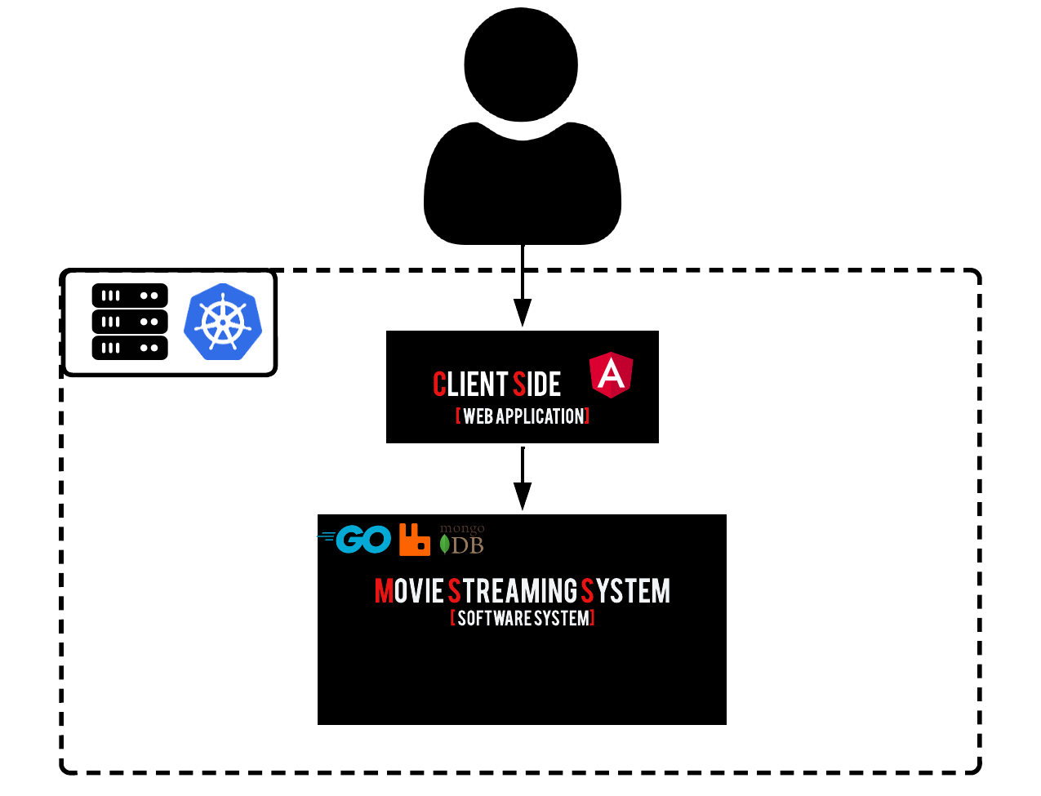
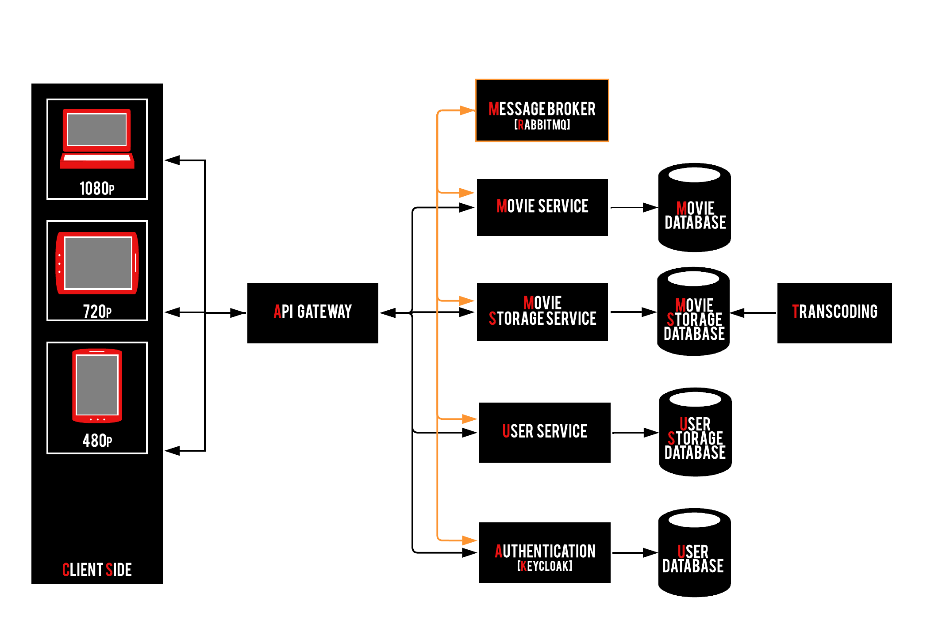
Architecture

Slide 6
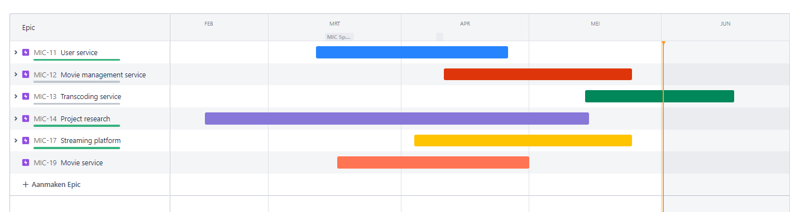
Enterprise Architecture & Software Platforms
Jira
Tested load balancing in Kubernetes cluster
Notes:
Enterprise applications (EA) are applications that are used in an enterprise context and are mainly used to satisfy the information management needs of an organization rather than individual users.

Slide 7
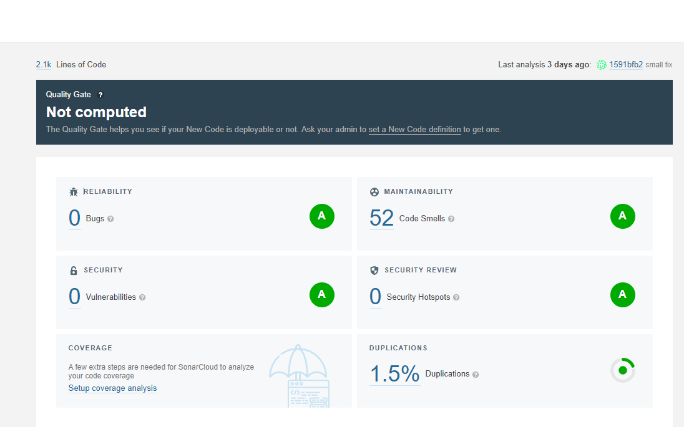
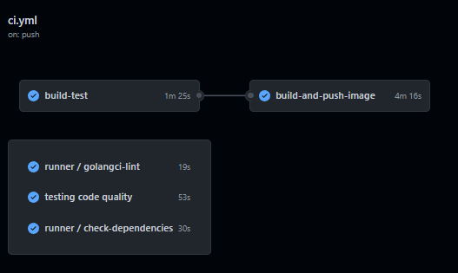
Architecture & Quality
Added SonarCloud to the CI/CD pipeline
Added a Testing job to the CI/CD pipeline
Added a dependency checker to the CI/CD pipeline

Slide 8
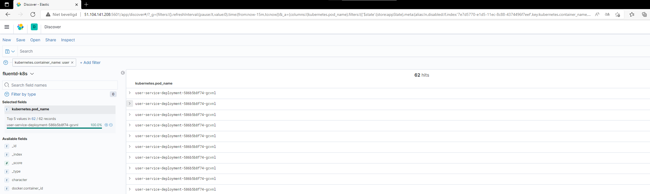
Messaging & Security-by-Design
Added the GDPR Analysis
Added logging using Elasticsearch
Added a performance test (NBomber) and Unit tests

Slide 9
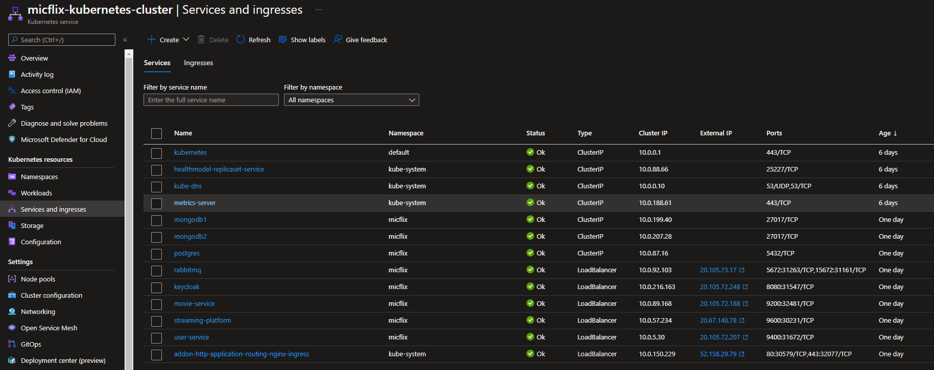
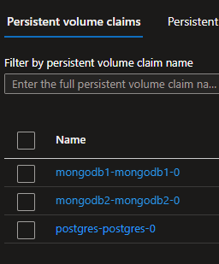
DevSecOps & Cloud Services
Researched how to use the Azure CLI image
Deployed the local cluster to Azure (Ingress problems)

Slide 10
DEMO

Slide 11
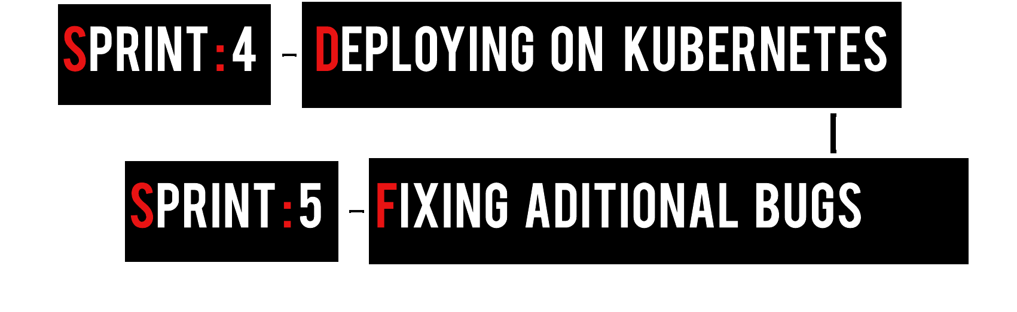
Roadmap

Slide 12
Next steps
Fixing ingress problem on Azure Kubernetes cluster
Testing the cluster with the performance tests
Adding the last improvements to the application for the final presentation.

